Slide 1
Concurrent Programming CT074-3-2 Version 0120
Introduction & Overview

Slide 2
Lecturer information
Name: Zailan Arabee
email: zailan@apu.edu.my
Location: FCET Staff Room Level 5
Tel: 03 8992 5079
Microsoft Teams!

Slide 3
Pre-requisites for this module
CT038-3-2-Object Oriented Development with Java
or equivalent

Slide 4
Aims of this module
The Concurrent Programming module aims to equip students with knowledge of concurrent and parallel programming , skills to implement concurrent technology, and an understanding of concurrency concepts. The concurrency concepts covered includes types, synchronisation and thread-safe concurrent programs.

Slide 5
Course Learning outcomes, CLOs
At the end of this course, YOU should be able to:
Explain the fundamental concepts of concurrency and parallelism in the design of a concurrent system (C2, PLO1)
Apply the concepts of concurrency and parallelism in the construction of a system using a suitable programming language. (C3, PLO2)
Explain the safety aspects of multi-threaded and parallel systems (A3, PLO6)

Slide 6
Mapping of CLOs with MOEs Domain
PLO2 – Cognitive Skills
PLO6 – Digital Skills

Slide 7
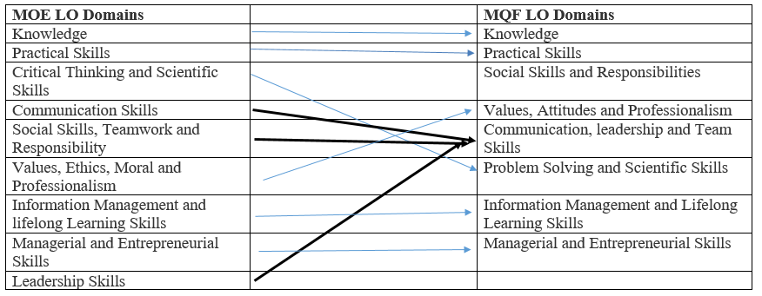
MQF and MOE Domains

Slide 8

Teaching Strategies
Lecture
Labs
Case Studies (Individual and Group)

Slide 9
Assessment Methods
Final Exam | 55%
Individual Assignment (Report- 1000 Words- Week 8) | 20%
Individual Assignment (System - 500 words- Week 12) | 25%
Total | 100%

Slide 10
Student Learning Time (SLT)
Course Credit Value: 3
Total Learning Hours:
Lectures : 28 hours per semester
Tutorial / Case Study : 14 hours per semester
Independent Learning Time: 54 hours

Slide 11
Methods of Delivery
Hence,
We are now moving from the traditional topic based teaching to outcome-based education

Slide 12
Outcomes Based Education (OBE)
OBE is education based on producing particular educational outcomes that:
Focus on what students can actually do after they are taught
Expect all learners / students to successfully achieve particular (sometimes minimum) level of knowledge and abilities.

Slide 13
So…What is OBE?
It’s
NOT
What we want to teach,
It’s
What You should learn

Slide 14
What is expected of you
What is expected of you
You should abide to all the rules & regulation of APU
Proper attire
No speaking of dialects
Attendance is compulsory and valid medical certificates or letters from parents /guardians must support any absence from class.
Three lateness will be equal to one absence
Mobile phones

Slide 15
Expectations
Commitment from you during sessions
Engagement in activities and labs
Record of engagement
Quizzes/Kahoot/etc.
EMR

Slide 16
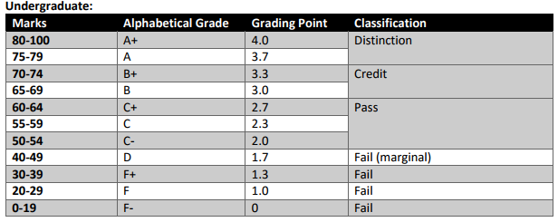
Achievement requirements

Slide 17
Skills
This module will give you the opportunity to develop the following skills
Understanding a specific body of knowledge and skills.
Analyse
Formulate a practical solution to a problem, making effective use of time and resources available.

Slide 18
What Support is available for you (I)
Lecturer consultation hours
Microsoft Teams
Slide 6 (of 11)

Slide 19
What Support is available for you (I)
Trobec, R. Slivnik, B (2018). Introduction to Parallel Computing: From Algorithms to Programming on State-of-the-Art Platforms. Springer. ISSN: 1863-7310
Goetz, B., Peierls, T. (2016). Java concurrency in practice. Pearson Education India. ISBN: 9332576521
*Raynal,M. (2013). Concurrent Programming: Algorithms, Principles, and Foundations. Springer. ISBN-13: 978-3642320262
*Wellings, A.(2004). Concurrent and Real-Time Programming in JAVA. Wiley. ISBN: 047084437X
*Magee, J. and Kramer, J. (2006) Concurrency: State Models & Java Programs. 2nd Edition. Wiley. ISBN:0470093552
*Ben-Ari,M. (2006). Principles of Concurrent and Distributed Programming. Prentice-Hall. ISBN: 0-321-31283-X
*Roosta,S.H. (2012). Parallel Processing and Parallel Algorithms: Theory and Computation. Springer. ISBN-13: 978-1461270485
Slide 6 (of 11)

Slide 20
Module Coverage
Introduction to Concurrent Programming :
Concurrency as abstract parallelism
The challenge of concurrent programming
Introduction to Parallel Programming :
The challenge of parallel programming
The terminology of concurrency and parallelism:
• Multitasking
• Multiple computers
Concurrency concepts :
• Concurrency types
• Round Robin
• Scheduler
• Priority
• Processes v Threads
• Synchronisation
• Asynchronicity
• Mutual exclusion
Concepts and Terminology
von Neumann Computer Architecture
Flynn's Classical Taxonomy
Some General Parallel Terminology
Limits and Costs of Parallel Programming
Parallel Programming Platforms
Implicit Parallelism
Parallel Computer Memory Architectures
Shared Memory
Distributed Memory
Hybrid Distributed-Shared Memory
Modeling Parallel Computation
MultiprocessorModels
Designing Parallel Programs
Understand the Problem and the Program
Communications
Synchronization
Data Dependencies
Granularity
Debugging
Performance Analysis and Tuning

Slide 21
Shared objects and Mutual Exclusion :
• Case Study: Ornamental garden problem
• Interference and Mutual Exclusion
Parallel Computational Complexity
Physical Organization of Parallel Platforms
Communication Costs in Parallel Machines
Principles of Parallel Algorithm Design
Decomposition Techniques
Characteristics of Tasks and Interactions
Advantages of concurrency :
• Standard safety issues
• liveness,
• starvation
• Race-condition
Classical problems :
• Semaphore
• Producer / Consumer
• Thread-safe concurrent programs.

Slide 22
IDE
Eclipse
Netbeans
IntelliJ

Slide 23
Java

Slide 24
What is expected of you - Class
Beginning of every class to review & discuss the material/content of the previous week
Seek clarity on assignment requirements
Refresh Java skills
Independence in coding and debugging

Slide 25
Question and Answer Session
Q & A

Slide 26
What we will cover next
Install IDE
Java 8 = JDK 1.8
Java quiz
What is concurrent and parallel programming?

